Slide 1

By:
Nitin Saraswat
AI for Managers

Slide 2
Why ML for MBA Graduates ?
Every Case Study involves data
The problem is the shape, volume an variety of data is changing with every passing moment
When solving case studies how can you incorporate the component of Data Analytics/Data Science

Slide 3
Why ML for MBA Graduates ?
In the book “Bulletproof Problem Solving” by two Ex-McKinsey Consultants -
Start your analysis with summary statistics, heuristics, and rules of thumb to get a feel for the data and the solution space.
In the Analysis Phase of Problem Solving , they mention -
“But Don't be afraid to employ big analytic guns when required”
What are those Big Analytics Guns –
Machine Learning Models including Supervised and Unsupervised Learning

Slide 4
What is ML?
Teaching Machines to learn
With enough labelled data
Label –
Ground Truth –
What about Unlabeled data ? Does it unlock any value ?

Slide 5
What is to be learned in ML ?
The Trend also called the Signal!
Data = Trend + Noise
Noise =Reducible + Irreducible
How to reduce the reducible noise ?
Capture the trend and not the noise

Slide 6
Tools of the Trade
Code heavy - R/Python/PySpark
Low Code - KNIME/Rapid Miner
No Code - Big ML/ Google AutoML

Slide 7
Mathematical Model
Suppose a Function describes a relationship between Salary and experience of an individual as given in the Salary_Data_graph.xlsx file
Predict the Salary of the individual at 5.9 years experience with Salary as target variable and Salary*35000 as a target variable

Slide 8
Machine Learning/Predictive Model
Now take the same data distribution of years of experience versus Salary, fit a linear regression model
And predict salary for 5.9 years experience for Salary as target variable

Slide 9
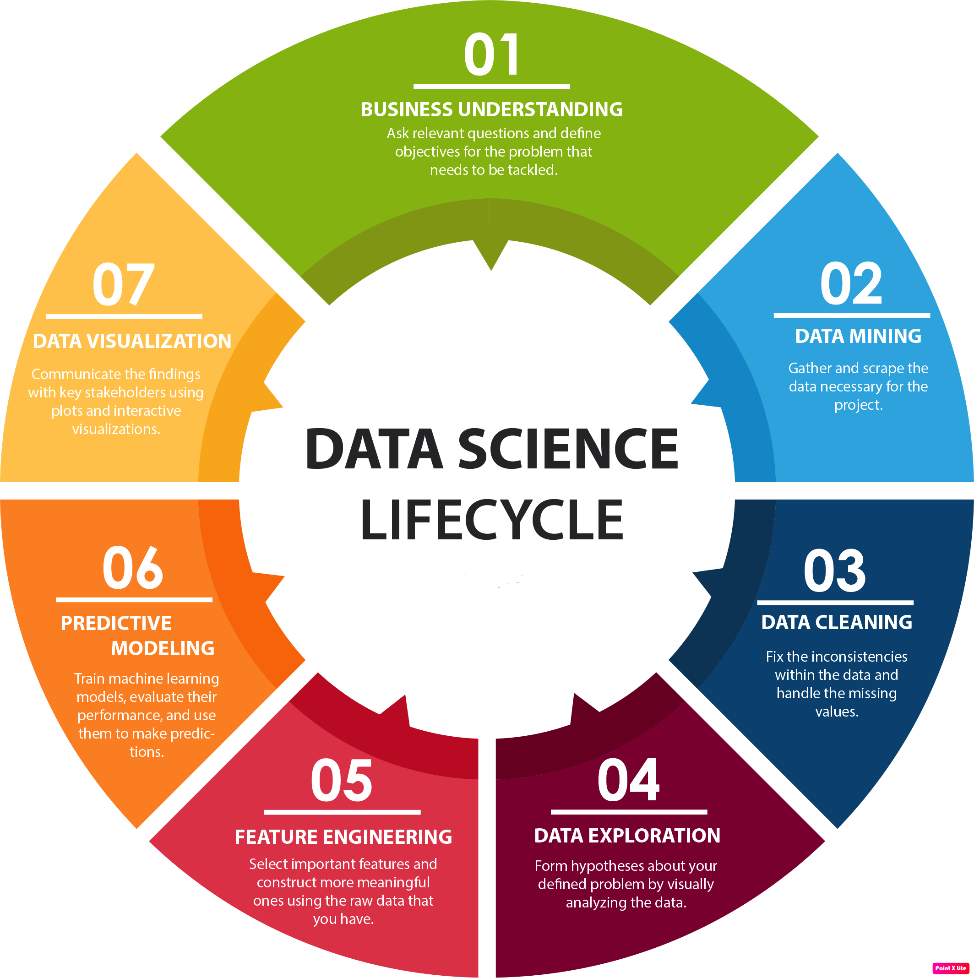
Machine Learning Life Cycle
Around 70% of the time is spent on data preparation including cleaning , transformation and making it usable for ML and visualization

Slide 10
Data Mining, Predictive Modeling, Machine Learning ..Arrgh!
Data Mining - Finding new information in a lot of data. Usually done in databases where lots of data is housed. Walmart mining its POS transactions data
Predictive Modeling/Statistical Modeling – Taking into account some mathematical/statistical assumptions about the data, apply some statistical modeling technique and come up with some predictions. Eg. Building Credit Risk Model
Machine Learning – Does not rely on data and algorithm assumptions and is more of an automated task once it is setup.
Data Science – is the big daddy of all – it encompasses everything . A Data Scientist is expected to do everything, right from
data extraction, data munging, implementing algorithms and even be decent with visualization. Now this is too much to ask for from a human being. So the idea is to be excellent at understanding algorithms, very good at data munging/extraction, good at visualization and for anything else he will be a part of some team (right ☺ )!
Bottom Line - You have some data collected about the process. Now all you need is curiosity and right tools to ask the right questions and find out the relevant answers. Remember - It’s not just about how complex algorithm has been fitted and how complex technology stack has been used – rather it is about were you able to solve the business problem

Slide 11
Is Data Science something new ?
Data Science is like Consulting with the Technology Component added to it
For me it is 60 -40 (though I would love it to be 20-80 , biased towards Technology) The hype around Data Science is not new. It has always been there - since Consultants have always been there.
Its just that, now it is in the open and has the ever strong support of Technology and cutting edge advancements in Machine Learning
To be a good Data Scientist - you should be super curious and question the status quo, kind of individual.
Unless you have lateral thinking and can think from different angles you wont be great at Data Exploration, Data pre-processing and finally applying algorithms.

Slide 12
Predictive Modeling vs Machine Learning
The main difference between the two techniques are the assumptions of the data generation process.
In the Predictive Modelling approach - assumption is that data is generated from a consistent but random data generation process. Hence the term 'modelling the data', and assuming various distributions etc.
In machine learning, the is no such assumption. The data generating process is a black box.
Machine learning algorithms can broadly be segmented into
Supervised Learning
Unsupervised Learning
Supervised Machine Learning Algorithms can be used for predictive analytics.
In supervised machine learning, we train the algorithm with labelled training set, e.g. given the weather conditions of 100 days and wanting to model which days would rain, we then choose an algorithm and feed it data about what the conditions were like on days where it rained, and on days where it did not rain. This trained model can then be applied on new data to predict if it will rain.

Slide 13
Predictive Modeling vs Machine Learning
Classical Statistics needs models to be built on the basis of past data, expert opinion etc. to establish relationship between the variables (predictor and predicted). And it needs to be tested for reliability, regularly maintained, calibrated and finally phased out
ML starts with the outcome and teaches a computer to automatically look for predictor variables and their interactions (might be very complex). The results are usually more accurate. Since the model is self learning(deep learning model which assigns a number to a shape it sees and learns using multiple neural network layers) with little or no assumptions it is quick to react on the changing input data and tweak itself.
Machine Learning is about building programs with tunable parameters (typically an array of floating point values, also called Hyperparameters) that are adjusted so as to improve their behavior by adapting to previously seen data
Machine learning is defined as the design and study of systems that learn from experience to improve their performance of a task as measured by a given metric.

Slide 14
So why this rush towards Machine Learning ?
Because of the changing scenarios and challenging use cases –
Recommendations – Product/ Content on Amazon/Netflix/You tube
Generating text/images based using some input provided by the user
Identifying Lung Cancer by looking at labelled images data and augmenting it with images generated by Generative Adversarial Networks
Automatic Answering of questions
And this list is growing at an unprecedented rate ..
Its not possible to tackle these problems using conventional Predictive Modeling hence Unsupervised , Deep Learning come into the picture and they are all a part of Machine Learning

Slide 15
Terminology used
Predictors, Explanatory Variable, Independent Variable – used for prediction
Target, Label , Dependent variable – to be predicted
Ground Truth - data known to be true by direct observation
Features – same as predictors
Feature Engineering – Creating new features by transformations

Slide 16
What is a Variable and Types of Variables
Statistically speaking
A variable on a high level can be –
Categorical
Continuous
Sub Types –
How to think about them and when to use what ?
This is a traditional variable taught in algebra class
Suppose x+1 =2 , so we can solve for x and the answer is 1
Usually lowercase

Slide 17
Then what is Random Variable?
Plain English definition – RV are ways to map outcomes of random processes to numbers. For e.g flipping a coin , rolling dice , measuring rain , Measuring salary of individuals, shoe size, weight – Usually denoted by uppercase letters (e.g Y, X)
Algebraic variables are denoted by lowercase letters (e.g y, x )
For e.g flipping a coin –
X = 1 if heads
X=0 if tails
So here X is a random variable
This “way” is sometimes called a function or a mapping - whatever – the idea is same
Some points in the domain of random processes (flipping coins, measuring rainfall, weight etc) get mapped to a real number
A random variable can take on many values with different probabilities
So we talk about the probability of a random variable equaling a value Or probability that it is <= or >= something

Slide 18
Then what is Random Variable?
So in layman terms –
We can say that
A random variable is a variable whose value is subject to variations due to chance (i.e. it’s value is stochastic).
Compared to other mathematical variables that are typically fixed values (though perhaps unknown), a random variable by definition does not have a single, fixed value (even if unknown).
Rather, a random variable can take on a set of possible different values (which may be finite or may be infinite).
A random variables is either discrete, where it can take on any of a specified list of specific values, or continuous, where it can take on a value in an interval or a set of intervals.

Slide 19
Discrete Random Variable
Now since we are talking about numbers so we would be dealing with two kinds of numbers –
Discrete and Continuous
As such, a random variable has a probability distribution
A discrete random variable is one which may take on only a countable number of distinct values such as 0,1,2,3,4,........
Discrete random variables are usually (but not necessarily) counts. If a random variable can take only a finite number of distinct values, then it must be discrete.
Examples of discrete random variables include the number of children in a family, the Friday night attendance at a cinema, the
number of patients in a doctor's surgery, the number of defective light bulbs in a box of ten.
Suppose we define a random variable X as –
X= Number of “Heads” after 3 flips of a fair coin
Lets plot a distribution for all possible combination of values when we flip a fair coin 3 times –

Slide 20
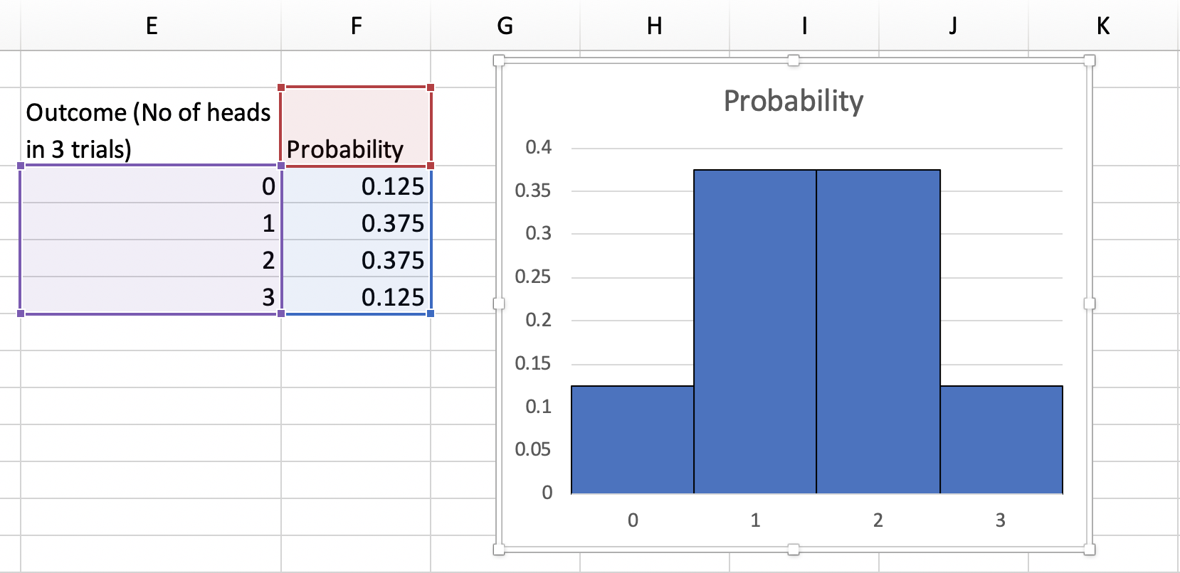
Discrete Random Variable
HHH
HHT
HTT
TTT
THH
TTH
THT
HTH
P(X=0) = 1/8
P(X=1) = 3/8
P(X=2)=3/8
P(X=3)=1/8
This is a Discrete Probability Distribution also known as Probability Mass function
There are two conditions which must be satisfied in order for this to a valid Probability Mass function –
1) p should lie between 0 and 1
2) sum of all probabilities for all events should be = 1

Slide 21
Continuous Random Variable
A continuous random variable is one which takes an infinite number of possible values.
Continuous random variables are usually measurements.
Examples include height, weight, the amount of sugar in an orange, the time required to run a mile.
Lets take the example of measuring height for all males in age range 18-25 in Gurgaon –
Lets start with the smallest number – maybe 4 feet and tallest maybe 8
Now there are infinitely many numbers in this range – so do you think the standard approach of calculating probability would work
Given that each number holds an equally likely probability to occur.
So to account for this we have a Probability Distribution that is continuous in nature and is called Probability Density Function

Slide 22
What is a Probability Density Function ?
Probability Density Function(PDF) for a Normal Distribution is a Bell Shaped
Curve which has some unique properties and one of the properties is the
area under the curve should be 1
Now how do we start from a simple distribution of data points given to us
(Nose Lengths) and create a density histogram from it and then create a PDF
Open up the file NoseLength.xlsx

Slide 23
What is a Density Histogram
We need to go from histogram of Nose Lengths to Probability density such
that area under the curve=1
Convert a Histogram into a Probability Density Function.
A density histogram is defined so that:
a) the area of each rectangle equals the relative frequency of the corresponding class, and
b) the area under the curve of the entire histogram equals 1
(A density histogram is just a modified relative frequency histogram)

Slide 24
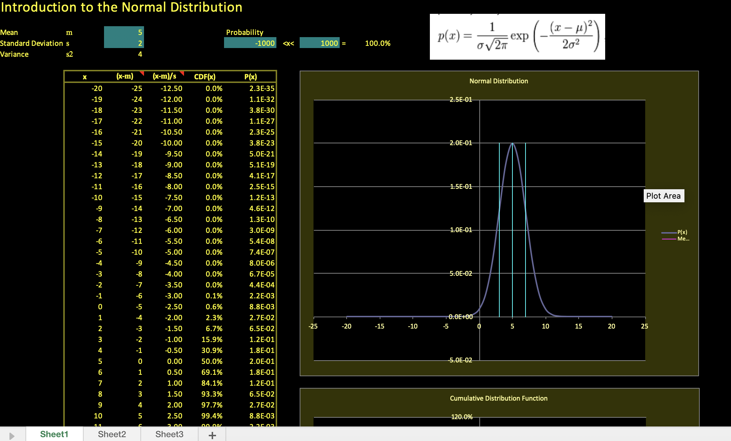
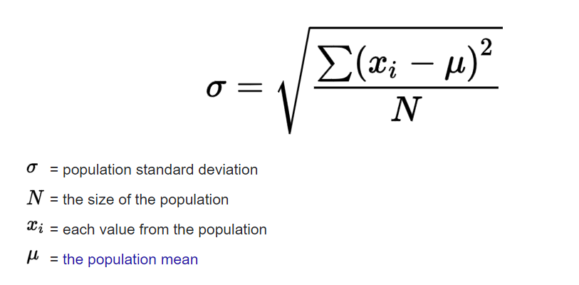
Quick Note on Probability Density Function for
Continuous Variables
For a continuous variable the probability at a single point does not matter since it can take any value in a given range
The probability distribution function we must use in the case is called a probability density function, which essentially assigns the probability that X is near each value. For intuition behind why we must use such a density rather than assigning individual probabilities
In order to get the probability - We multiply the probability density by the interval of the event which is precisely done when we solve this integration
Open the file called – NormalIntro.xlsx
And tinker with the values of mean and standard deviation to
See how the Pdf varies
Standard Deviation =

Slide 25
Uniform Distribution and Normal Distribution
In an Uniform Distribution each data point has an equal probability to be picked
whereas (picking a card from a deck of cards, rolling a dice)
• In a Normal Distribution the numbers closer to the mean are more likely to be
picked than those far away from the mean
Whenever we talk about probabilities in Distributions we are always looking for
area under the curve .
Total Area under the curve of any distribution (owing to the property of
Probability Density Function) =1
So if there are 10 data points in an uniform distribution then –
Each point will have a probability of 0.1 (See figure on next page)

Slide 26
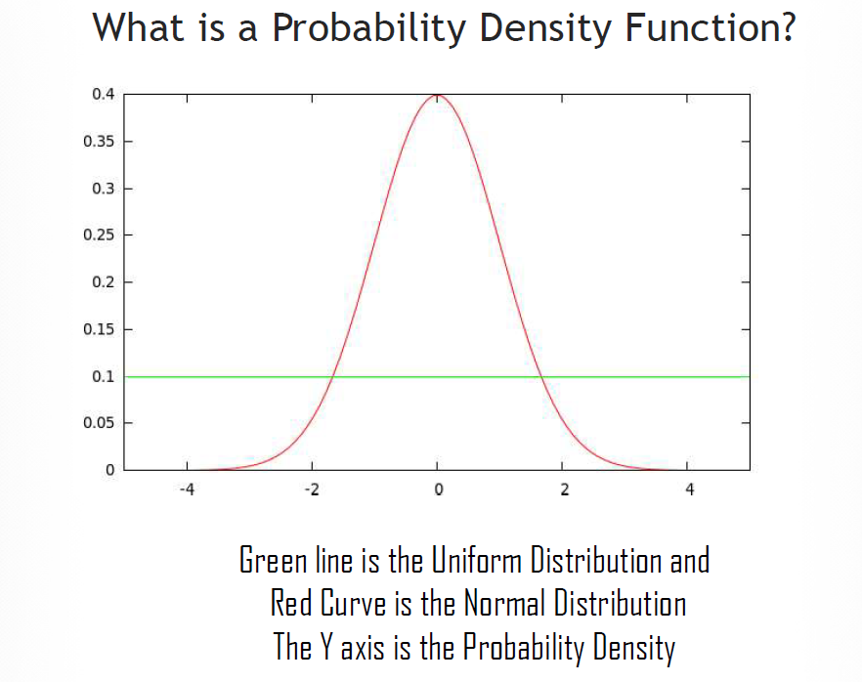
Comparison of PDFs of Uniform and Normal Distribution

Slide 27
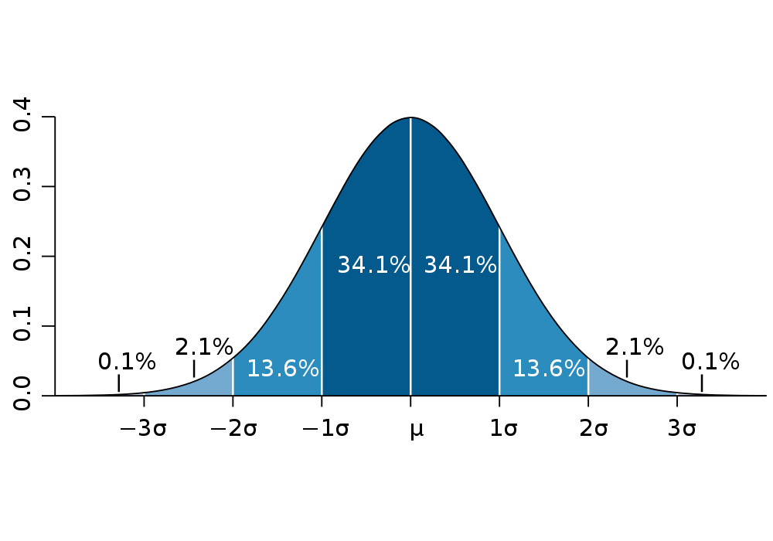
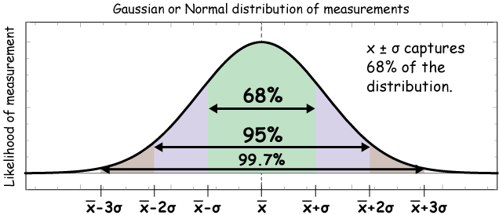
Normal Distribution ~ N (μ, σ )
PDF - function of a continuous random variable, whose integral across an interval gives the probability that the value of the variable lies within the same interval.
We can see that Mean (x bar, or mu) and standard deviation (sigma) define any data distribution ( and ultimately probability density function)
Standard deviation is defined as ->

Slide 28
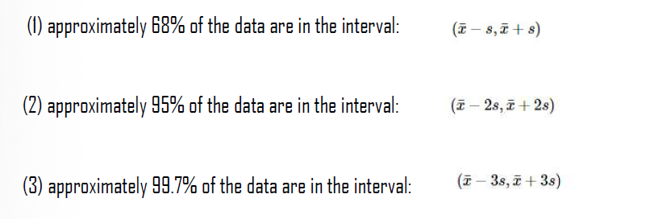
Empirical Rule in Normal Distribution
We've previously learned that the sample mean can be thought of as the "center" of a set of data, while the sample standard deviation indicates "how spread out" the data are from the sample mean.
Now, if a histogram is "mound shaped" or "bell-shaped," then we can use the sample mean, sample standard deviation, and what is called the Empirical Rule to determine three intervals for which we would expect approximately 68%, 95%, and 99.7% of the data to fall.
The Empirical Rule tells us that given a Normal Distribution following proportion of data will fall under 1 sd, 2 sd and 3 sd -

Slide 29
Empirical Rule – Question
Q. The federal government's average income from federal income taxes (on a per capita basis) for each of the 50 states in fiscal year 1991 is $1252.44 with a standard deviation of $393.75. If a tax payer says he paid $2806 as taxes in last financial year, determine the likelihood whether he is stating truth or providing false information
(Assuming the data is approximately Normally Distributed)

Slide 30
Empirical Rule – Solution
Ans. The Empirical Rule tells us that we can expect 68% of the per capita taxes to fall
between:
x-s=$1252.44−$393.75=$858.69
x+s=$1252.44+$393.75=$1646.19
The Empirical Rule also tells us that we can expect 95% of the per capita taxes to fall
between:
x-2s=$1252.44−2($393.75)=$464.94
x+2s=$1252.44+2($393.75)=$2039.94
The Empirical Rule also tells us that we can expect 99.7% (virtually all!) of the per capita
taxes to fall between:
x-3s=$1252.44−3($393.75)=$71.19
x+3s=$1252.44+3($393.75)=$2433.69
The number $2806 falls outside the range of 99.7 % population hence it is unlikely he paid those taxes

Slide 31
Normal Distribution – Questions and Solutions
Problem 1:
An average light bulb manufactured by the Acme Corporation lasts 300 days with a standard deviation of 50 days. Assuming that bulb life is normally distributed, what is the probability that an Acme light bulb will last at most 365 days?
Solution: Given a mean score of 300 days and a standard deviation of 50 days, we want to find the cumulative probability that bulb life is less than or equal to 365 days.
Thus, we know the following:
The value of the normal random variable is 365 days.
The mean is equal to 300 days.
The standard deviation is equal to 50 days.

Slide 32
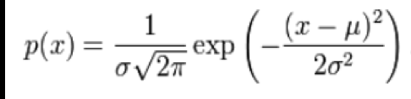
Normal Distribution – Questions and Solutions
Solution Contd:
Essentially what we want to find it P( X <= 365) ?
Solution: Given a mean score of 300 days and a standard deviation of 50 days, we want to find the cumulative probability that bulb life is less than or equal to 365 days.
Thus, we know the following:
The value of the normal random variable is 365 days.
The mean is equal to 300 days.
The standard deviation is equal to 50 days.
Essentially we have to solve the integral
https://www.integral-calculator.com/
https://www.wolframalpha.com/calculators/integral-calculator/

Slide 33
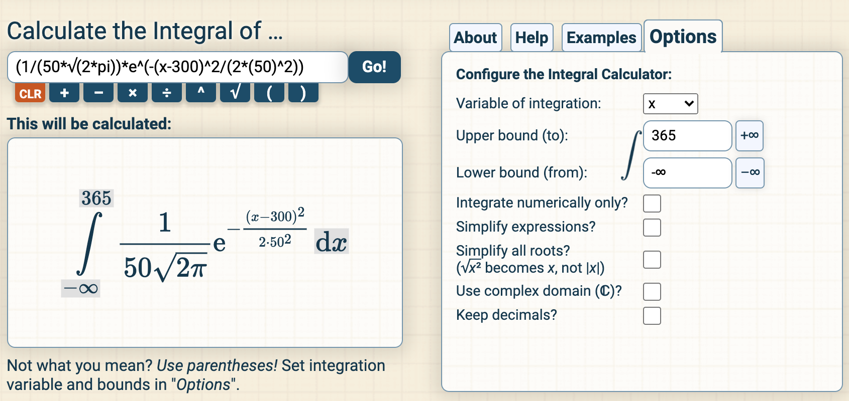
Normal Distribution – Questions and Solutions
Solution Contd:
Values that need to be punched in the calculator –
The answer is: P( X < 365) = 0.90. Hence, there is a 90% chance that a light bulb will burn out within 365 days
And this is given by Cumulative Probability

Slide 34
Normal Distribution – Questions and Solutions
Problem 2:
Suppose scores on an IQ test are normally distributed. If the test has a mean of 100 and a standard deviation of 10, what is the probability that a person who takes the test will score between 90 and 110?
Solution:
Here, we want to know the probability that the test score falls between 90 and 110.
The "trick" to solving this problem is to realize the following:
P( 90 < X < 110 ) = P( X < 110 ) - P( X < 90 )
To compute P( X < 110 ), we enter the following inputs into the calculator: The value of the normal random variable is 110, the mean is 100, and the standard deviation is 10. We find that P( X < 110 ) is 0.84.
To compute P( X < 90 ), we enter the following inputs into the calculator: The value of the normal random variable is 90, the mean is 100, and the standard deviation is 10. We find that P( X < 90 ) is 0.16.

Slide 35
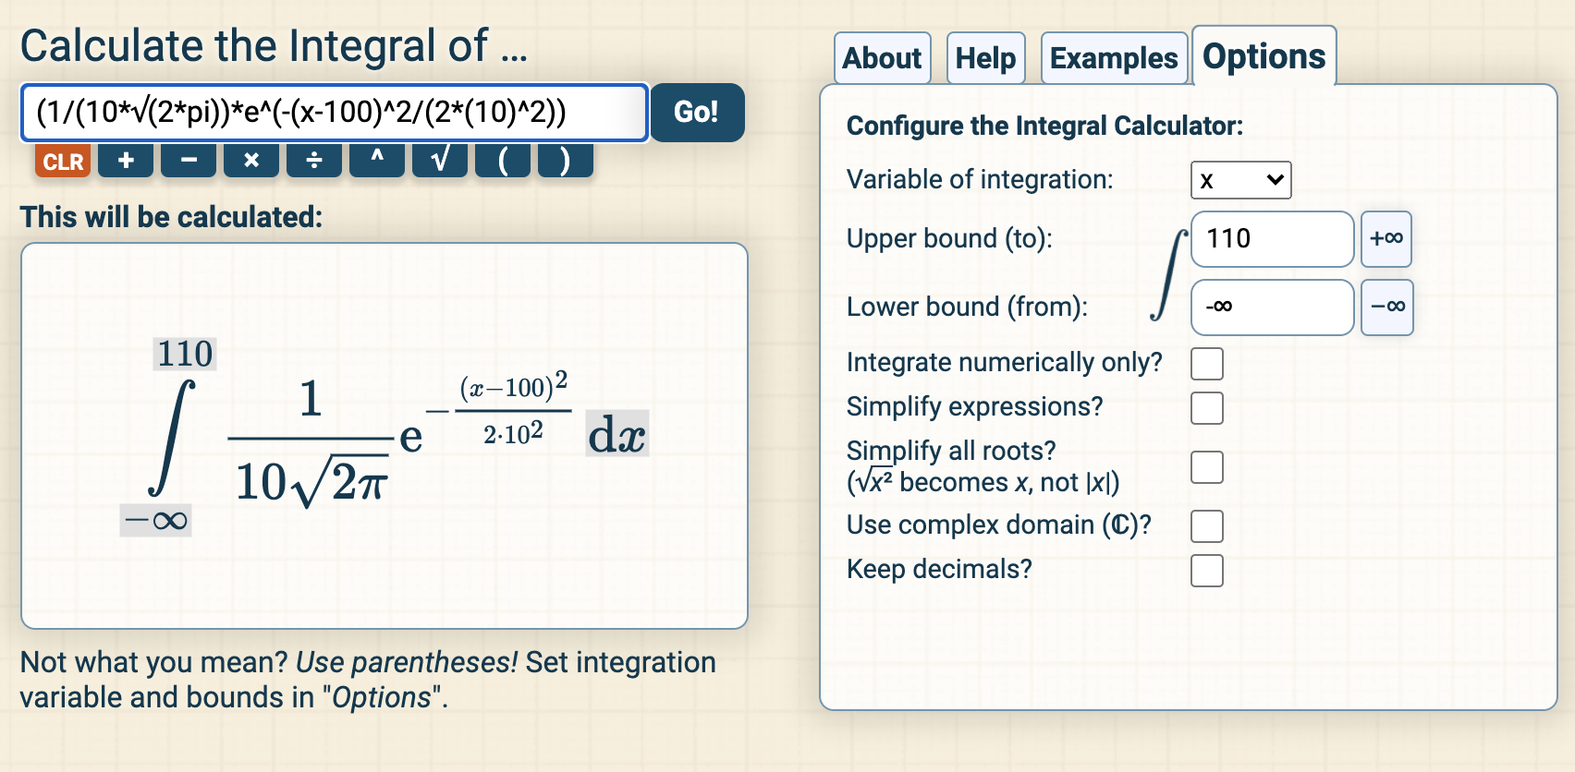
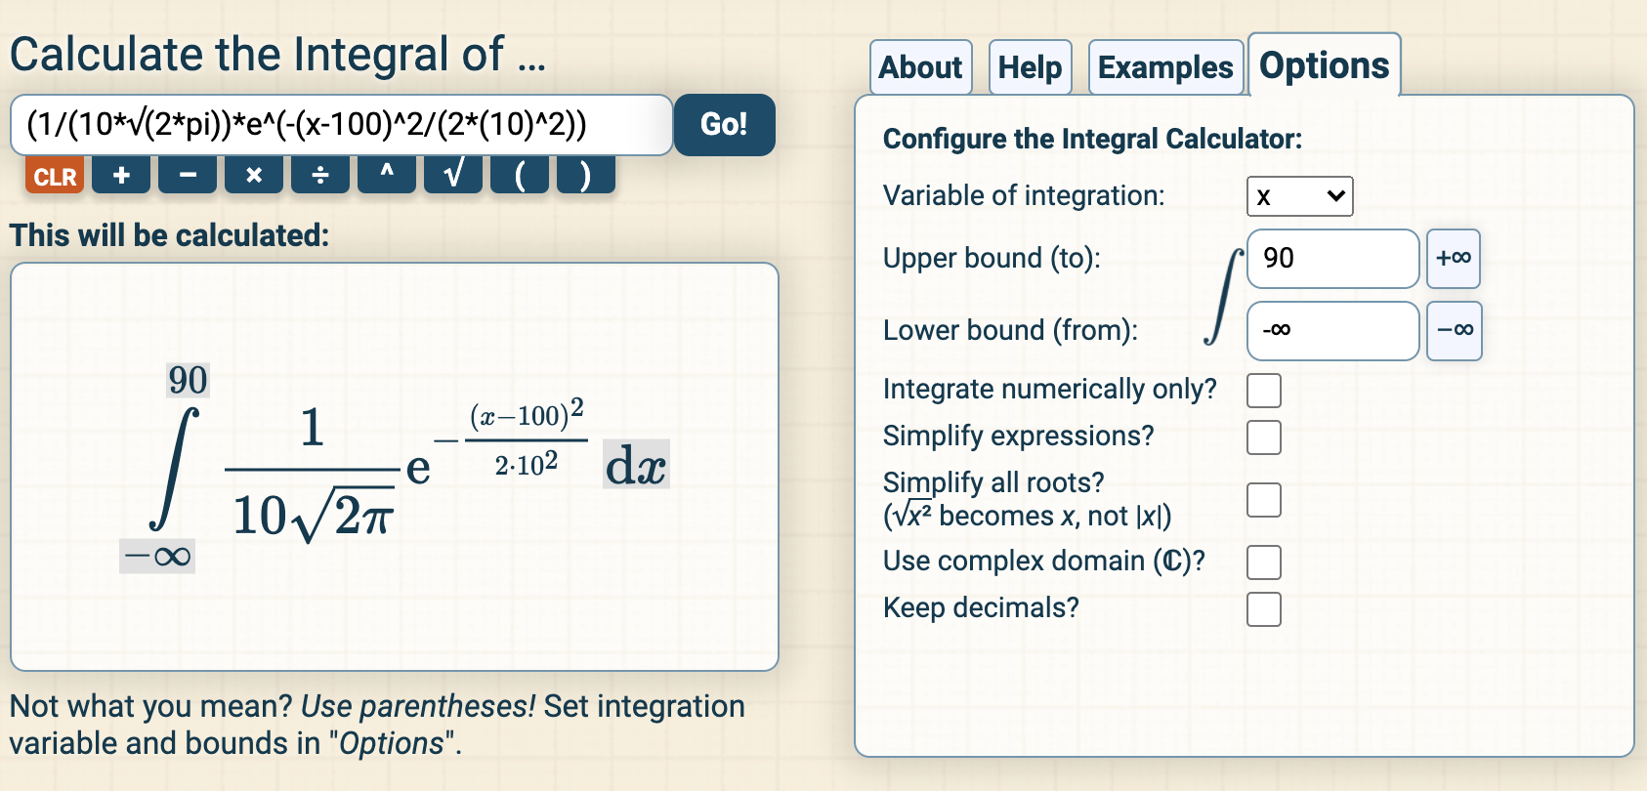
Normal Distribution – Questions and Solutions
We use these findings to compute our final answer as follows:
P( 90 < X < 110 ) = P( X < 110 ) - P( X < 90 )
P( X < 110 ) = 0.84
P( X < 90 ) = 0.16
P( 90 < X < 110 ) = 0.84 - 0.16 P( 90 < X < 110 ) = 0.68
Thus, about 68% of the test scores will fall between 90 and 110.

Slide 36
Standard Normal Distribution
Standard Normal Distribution is a special case of Normal Distribution
When a normal random variable has mean of 0 and standard deviation =1 then the distribution is called Standard Normal Distribution
Now any Normal Distribution can be converted into Standard Normal Distribution
Motivation to do this –
As discussed there are many many random variables all around us –
e.g
Output in terms of “weight of apples” of each apple orchard in Himachal Pradesh (measurement metric is kg)
Annual Salary of individuals in AON (measurement metric is INR)
Time taken to run 100 metre sprint in 2018 Seoul Olympics (measurement metric is seconds)
Amount of rainfall in Jaiselmer in last 10 years (measurement metric is mm)
Mean Monthly temperature of Dubai for last 10 years (measurement metric is degree Centigrade)
And so on and do forth
The point is there are many random variables and when pdfs are plotted for them even if they follow a normal distribution will have different metrics and so it would be difficult to have different plots for them and then using that plot to calculate the probabilities for different values of the random variable

Slide 37
Standard Normal Distribution
As the term suggests it is computed from Normal Distribution by standardizing it –
The normal random variable of a standard normal distribution is called a standard score or a z-score.
Any normal random variable X can be transformed into a z-score via the following equation:
z = (x - μ) / σ
Where z= z-score or standard score
X= random variable
μ= mean of X
σ=sd of X
Think for a second about possible values that z-score can take

Slide 38
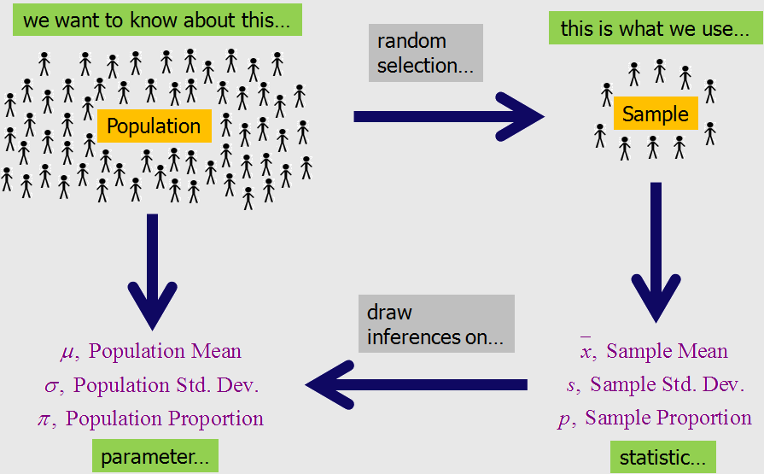
Population and Sample

Slide 39
Plot t-distribution
What is t distribution ?
T-Distribution or Student t-distribution is a Continuous Probability Distribution that arise when estimating the mean of a Normally Distributed Population in situations when sample size is small
Parameters -
Degree of freedom = n-1 ( n is the number of data points)
Mean
Standard deviation
T-Distribution looks more or less like a standard normal distribution but it has heavier tails.
How do we compute the t –value (it is similar to the z score)
T= (x - μ) / (s/√n)
mu= mean
S=standard deviation of sample

Slide 40
What is Central Limit Theorem
The central limit theorem states that if you have a population with mean μ and standard deviation σ and take sufficiently large random samples from the population with replacement then the distribution of the sample means will be approximately normally distributed.
This will hold true regardless of whether the source population is normal or skewed, provided the sample size is sufficiently large (usually n > 30). If the population is normal, then the theorem holds true even for samples smaller than 30. In fact, this also holds true even if the population is binomial, provided that min(np, n(1-p))> 5, where n is the sample size and p is the probability of success in the population.
This means that we can use the normal probability model to quantify uncertainty when making inferences about a population mean based on the sample mean.

Slide 41
Why is it useful ?
The Central Limit Theorem is important for statistics because it allows us to safely assume that the sampling distribution of the mean will be normal in most cases. This means that we can take advantage of statistical techniques that assume a normal distribution
Try taking multiple samples from different types of distributions and try to plot their data distributions?
What do you observe ?
Open a blank excel file and Use Data Analysis add-in to generate data distributions for Uniform, Binomial and Poisson

Slide 42
Hypothesis Testing
What does distributions help us with and What is Hypothesis Testing ?
A Hypothesis is a claim(assumption) about a population parameter
Population mean
Population proportion
The Null Hypothesis, H0 :
States the claim or assertion to be tested
For e.g: The average number of SIM cards per Individual in India is 2 (H0: µ =2)
Is always about a population parameter and not a sample statistic
Begin with the assumption that the null hypothesis is true (similar to the notion of innocent until proven guilty)
Refers to the status quo or historical value
Always contains “=“, ”<=“, “>=“ sign
May or may not be rejected

Slide 43
Hypothesis Testing
The Alternative Hypothesis , H1:
For e.g: The average number of SIM Cards per individual in India is not equal to 2 (H1: µ ≠ 2)
Challenges the status quo
Never contains “=“ , “<=“, ”>=“ sign
May or may not be proven
Is generally the hypothesis the researcher is trying to prove
Now what helps us determine whether the NULL hypothesis is rejected or have we failed to reject the NULL hypothesis –
The answer is - Statistical Tests
To reject a NULL hypothesis a test statistic is calculated

Slide 44
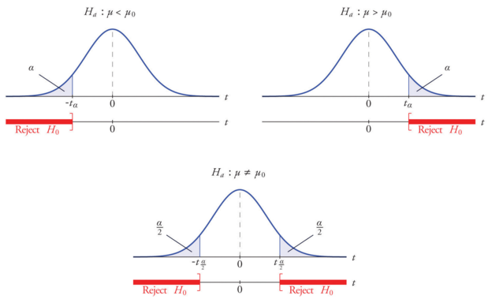
Hypothesis Testing
This test-statistic is then compared with a critical value and if it is found to be greater than the critical value the hypothesis is rejected.
“In the theoretical underpinnings, hypothesis tests are based on the notion of critical regions: the null hypothesis is rejected if the test statistic falls in the critical region. The critical values are the boundaries of the critical region.
if the test is one-sided (like a χ2 test or a one-sided t-test) then there will be just one critical value, but in other cases (like a two-sided t-test) there will be two”.

Slide 45
Hypothesis Testing – Critical Value
A critical value is a point (or points) on the scale of the test statistic beyond which we reject the null hypothesis, and, is derived from the level of significance α of the test. Alpha level is the probability of rejecting the null hypothesis when it is true. For example, a significance level of 0.05 indicates a 5% risk of concluding that a difference exists when there is no actual difference
Critical value can tell us, what is the probability of two sample means belonging to the same distribution.
Higher, the critical value means lower the probability of two samples belonging to same distribution.
The general critical value for a two-tailed test is 1.96, which is based on the fact that 95% of the area of a normal distribution is within 1.96 standard deviations of the mean
Critical values can be used to do hypothesis testing in following way –
1. Calculate test statistic
2. Calculate critical values based on significance level alpha
3. Compare test statistic with critical values
If the test statistic is lower than the critical value, fail to reject the NULL hypothesis, else reject the NULL hypothesis

Slide 46
Hypothesis Testing – p-value
Suppose we say alpha =0.05 – Level of significance – Probability of rejecting the NULL Hypothesis when it is actually true ( Type I error)
Now in a 2 tailed t-test (on a normal distribution curve) to calculate critical value at 45% alpha we (algorithm) looks up 0.45 in t-table and gives us a specific number which becomes our critical value. So this critical value is derived from the table
Now when we run our actual test (and we can see the formula to calculate t-value) a new value is found and we get a p-value
These two values are compared to see if we can reject or fail to reject the NULL Hypothesis
The p-value is basically the probability of obtaining your sample data IF the null hypothesis (e.g., no of SIM Cards= 2) were true
So if we obtain a p-value of 0.85, then you have little reason to doubt the null hypothesis
However, if your p-value is say 0.02, there’s only a very small chance you would have obtained that data if the null hypothesis was in fact true
And since the p-value is a probability just like alpha, p-values also range from 0 to 1.
This whole exercise means then when p value or test statistic (t value or z score) is below the significance level or critical value then we reject the null hypothesis since the value obtained for that variable is not by chance and it actually represents true population parameter.

Slide 47
Result of Hypothesis Testing
Outcome of Hypothesis Testing –
Reject the Null Hypothesis
Fail to reject the Null Hypothesis
Given a PDF (t distribution or SND) –>
area of rejection/acceptance (at a given level of significance/degree of freedom)–>
tc critical value for a given sample size (known from t table)->
t calculated from the sample data ->
If t < tc then reject the NULL Hypothesis else Fail to reject the Null Hypothesis

Slide 48
T-test example
Problem 1:
The concentration of trace metal iron in the air: A researcher at an environmental section wishes to verify the claim that the mean concentration of trace metal iron (Fe) on coarse particulate matter (PM10) in the air is 0.36 (µg/m³⁾ during the summer season of an equatorial urban coastal location. Twelve samples were selected, and the concentration of iron was measured. The collected data showed that the mean concentration of iron is 0.44 and the standard deviation is 0.34. A significance level of α=0.01 is chosen to test the claim. Assume that the population is normally distributed.

Slide 49
T-test example
Problem 1:
The concentration of trace metal iron in the air: A researcher at an environmental section wishes to verify the claim that the mean concentration of trace metal iron (Fe) on coarse particulate matter (PM10) in the air is 0.36 (µg/m³⁾ during the summer season of an equatorial urban coastal location. Twelve samples were selected, and the concentration of iron was measured. The collected data showed that the mean concentration of iron is 0.44 and the standard deviation is 0.34. A significance level of α=0.01 is chosen to test the claim. Assume that the population is normally distributed.
Step 0: Look at sample size and determine what test statistic and what probability distribution should be considered for Hypothesis Testing

Slide 50
T-test example
Problem 1:
The concentration of trace metal iron in the air: A researcher at an environmental section wishes to verify the claim that the mean concentration of trace metal iron (Fe) on coarse particulate matter (PM10) in the air is 0.36 (µg/m³⁾ during the summer season of an equatorial urban coastal location. Twelve samples were selected, and the concentration of iron was measured. The collected data showed that the mean concentration of iron is 0.44 and the standard deviation is 0.34. A significance level of α=0.01 is chosen to test the claim. Assume that the population is normally distributed.
Step 0: Look at sample size and determine what test statistic and what probability distribution should be considered for Hypothesis Testing
The general procedure for conducting hypothesis testing can be used to make the decision regarding the mean concentration of iron in the air. Because the sample size is small n=12, a t-test should be employed to test the hypothesis regarding the mean concentration of iron in the air.

Slide 51
T-test example
Problem 1:
The concentration of trace metal iron in the air: A researcher at an environmental section wishes to verify the claim that the mean concentration of trace metal iron (Fe) on coarse particulate matter (PM10) in the air is 0.36 (µg/m³⁾ during the summer season of an equatorial urban coastal location. Twelve samples were selected, and the concentration of iron was measured. The collected data showed that the mean concentration of iron is 0.44 and the standard deviation is 0.34. A significance level of α=0.01 is chosen to test the claim. Assume that the population is normally distributed.
Step 1: Specify the Null and Alternative Hypothesis
The mean concentration of iron in the air (μ) is 0.36, this claim should be under the null hypothesis because the claim represents equality . If the mean concentration of iron in the air is not equal to 0.36, then two cases should be considered,
the first case could be the mean concentration of iron in the air is greater than 0.36 and the second case could be the mean concentration of iron in the air is less than 0.36. The two cases (greater than and less than) can be represented mathematically
as <> . Thus we can write the two hypotheses (null and alternative) as presented below -
H0:μ=0.36 vs H1:μ<> 0.36
We should make a decision regarding the null hypothesis whether the mean concentration of iron in the air is exactly equal to 0.36, or the mean concentration of iron in the air differs (more or less) from 0.36.

Slide 52
T-test example
Problem 1:
The concentration of trace metal iron in the air: A researcher at an environmental section wishes to verify the claim that the mean concentration of trace metal iron (Fe) on coarse particulate matter (PM10) in the air is 0.36 (µg/m³⁾ during the summer season of an equatorial urban coastal location. Twelve samples were selected, and the concentration of iron was measured. The collected data showed that the mean concentration of iron is 0.44 and the standard deviation is 0.34. A significance level of α=0.01 is chosen to test the claim. Assume that the population is normally distributed.
Step 2: Select the significance level of study (think about two tailed or one-tailed)
The significance level of 0.01 (α=0.01) is selected to test the hypothesis. We divide the value of the significance level (0.01) by 2 to represent the two-tailed test (more or less) of the alternative hypothesis, thus α α =0.005 which represents the rejection region in each tail of the t distribution curve (the left and right tails).
The t critical value for the two-tailed test with α=0.01 and d.f=11 is 3.106 as appeared in the t table (shared with you).
Thus the t critical values for both sides are +-3.106, we use the two t critical values to make a decision whether to
reject or fail to reject the null hypothesis

Slide 53
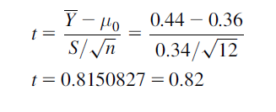
T-test example
Problem 1:
The concentration of trace metal iron in the air: A researcher at an environmental section wishes to verify the claim that the mean concentration of trace metal iron (Fe) on coarse particulate matter (PM10) in the air is 0.36 (µg/m³⁾ during the summer season of an equatorial urban coastal location. Twelve samples were selected, and the concentration of iron was measured. The collected data showed that the mean concentration of iron is 0.44 and the standard deviation is 0.34. A significance level of α=0.01 is chosen to test the claim. Assume that the population is normally distributed.
Step 3: Use the sample information to calculate the test statistic value
The entries for the t-test statistic formula as presented in equation below . The claimed value for the mean concentration of iron (μ0) is 0.36, the mean concentration of iron calculated from the sample data is 0.44, the standard deviation for the concentration of iron is 0.34 and the sample size (n) is 12. We apply the formula presented below to test the hypothesis regarding the mean concentration of iron in the air.
The test statistic value for the mean concentration of iron in the air is found to be 0.82.

Slide 54
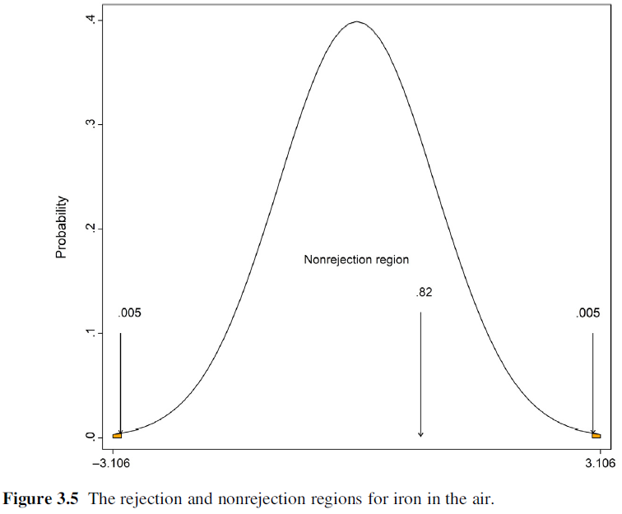
T-test example
Problem 1:
The concentration of trace metal iron in the air: A researcher at an environmental section wishes to verify the claim that the mean concentration of trace metal iron (Fe) on coarse particulate matter (PM10) in the air is 0.36 (µg/m³⁾ during the summer season of an equatorial urban coastal location. Twelve samples were selected, and the concentration of iron was measured. The collected data showed that the mean concentration of iron is 0.44 and the standard deviation is 0.34. A significance level of α=0.01 is chosen to test the claim. Assume that the population is normally distributed.
Step 4: Identify the critical and non-critical regions
We can easily identify the rejection and nonrejection regions for a two-tailed
test employing the t critical values found in step 2.
The rejection and nonrejection regions for the mean concentration of iron in the
air are presented in below figure for the t distribution curve (shaded area).

Slide 55
T-test example
Problem 1:
The concentration of trace metal iron in the air: A researcher at an environmental section wishes to verify the claim that the mean concentration of trace metal iron (Fe) on coarse particulate matter (PM10) in the air is 0.36 (µg/m³⁾ during the summer season of an equatorial urban coastal location. Twelve samples were selected, and the concentration of iron was measured. The collected data showed that the mean concentration of iron is 0.44 and the standard deviation is 0.34. A significance level of α=0.01 is chosen to test the claim. Assume that the population is normally distributed.
Step 5: Make a decision and interpret the results
One can observe that the null hypothesis should not be rejected because the test statistic value of the t-test calculated from the sample data is 0.82, which is less than the t critical value for the two-tailed test (3.106). Moreover, one can use a t
distribution curve to decide, the same decision (fail to reject the null hypothesis) can be reached using the t distribution curve and it can be seen that the test statistic value falls in the nonrejection region as shown in Fig. 3.5.
The null hypothesisis not rejected and we believe that the mean concentration of iron in the air is equal to 0.36.

Slide 56
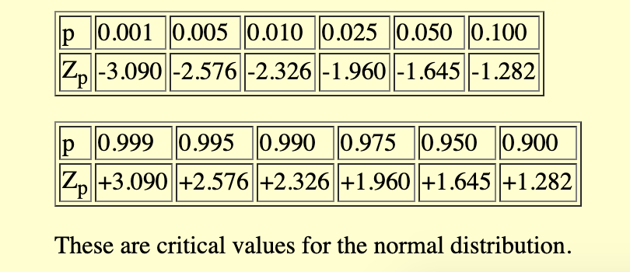
Hypothesis Testing – p-value –Some examples
Suppose we say alpha =0.05 – Level of significance – Probability of rejecting the NULL Hypothesis when it is actually true ( Type I error)
A value of α = 0.05 implies that the null hypothesis is rejected 5 % of the time when it is in fact true.
Critical values for z-score for various levels of significance ( Refer to the Z table or Standard Normal Distribution Table)

Slide 57
Some info on z-score
Here are some important facts about z-scores:
A positive z-score says the data point is above average.
A negative z-score says the data point is below average.
A z-score close to 0 says the data point is close to average.
A data point can be considered unusual if its z-score is above +3 or below -3 (outlier)

Slide 58
Questions on z-score
Problem 1 :
Last year many college-bound high school seniors in the U.S. took the Scholastic Aptitude Test (SAT). For the verbal portion of this test, the mean was 425 and the standard deviation was 110. Based on this information what percentage of students would be expected to score between 350 and 550?

Slide 59
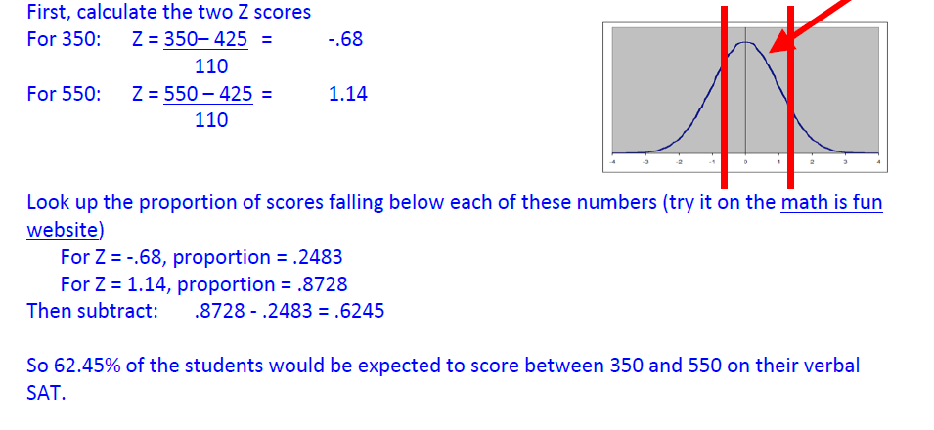
Questions on z-score
Problem 1 :
Last year many college-bound high school seniors in the U.S. took the Scholastic Aptitude Test (SAT). For the verbal portion of this test, the mean was 425 and the standard deviation was 110. Based on this information what percentage of students would be expected to score between 350 and 550?

Slide 60
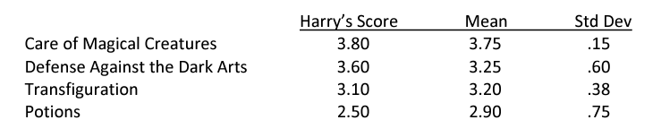
Questions on z-score
Problem 2 :
At Hogwarts School of Witchcraft and Wizardry, Professor Snape was concerned about grade inflation, and suggested that the school should issue standardized grades (or z-scores), in addition to the regular grades. How might this work? Harry was in four classes, each with 20 students. Harry’s score, the class mean, and the class standard deviation are given below. Compute his standardized grade in each class. If we judged by standardized grades, where did he do best? Where did he do worst?

Slide 61
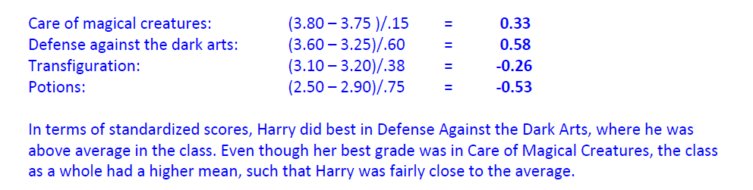
Questions on z-score
Problem 2 :

Slide 62
Questions on z-score
Problem 3 :
On an average, it takes Han Solo 45 seconds to check the coordinates and make the jump into hyperspace. The standard deviation on this important task is 5 seconds. When Han and Chewbacca and their passengers are leaving for Alderaan they make the jump in 33 seconds or less. What is the probability of such an accomplishment?

Slide 63
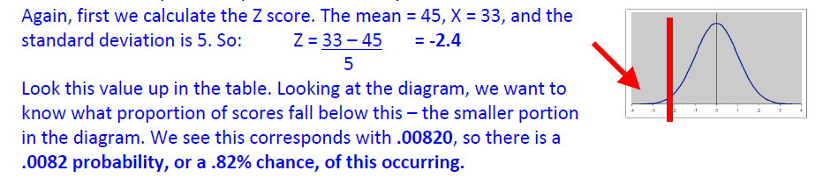
Questions on z-score
Problem 3 :
On an average, it takes Han Solo 45 seconds to check the coordinates and make the jump into hyperspace. The standard deviation on this important task is 5 seconds. When Han and Chewbacca and their passengers are leaving for Alderaan they make the jump in 33 seconds or less. What is the probability of such an accomplishment?

Slide 64
Questions on z-score
Problem 4 :
Jawas, those jewel-eyes, hooded collectors of robots and scrap, live in the desert and travel by sandcrawler. Their height is normally distributed with a mean of four feet and a standard deviation of 3 inches. The escape exit on the sandcrawler is 46 inches high. What proportion of the Jawas must duck when they use the escape exit?

Slide 65
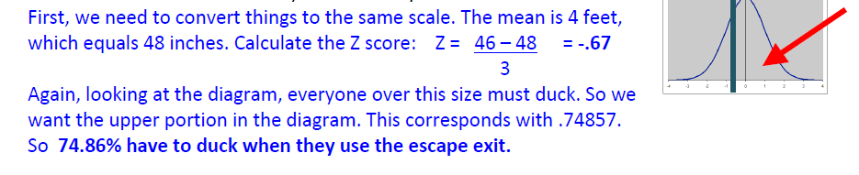
Questions on z-score
Problem 4 :
Jawas, those jewel-eyes, hooded collectors of robots and scrap, live in the desert and travel by sandcrawler. Their height is normally distributed with a mean of four feet and a standard deviation of 3 inches. The escape exit on the sandcrawler is 46 inches high. What proportion of the Jawas must duck when they use the escape exit?

Slide 66
Python/Excel/SQL ?
At the end of the day data needs to be pulled and analysed
SQL is your best shot - works in any programming language, platform ..
SQL is a skill once acquired will help you everywhere where there is data (tabular data – rows and columns)
Tables
Rows
Columns
Joins
String, Numeric, Date functions
We will have some hands on in Python on this

Slide 67
Why Python when we already have Excel ?
Scale
Speed
Community Support (You have a problem , chances are there would be solution ..)
Follow python_excel.ipynb
SQL queries in which you need to join on multiple columns and then pull different columns
Unstructured, Semi-structured data like JSON, XML can be read and processed in python
Python programming language is not just for Machine Learning but a complete package in its own right
Network Programming
File Handling
And so on ..

Slide 68
Broad Categories of Variables present in the data (also called fields/columns)
Open ds notebook
So, broadly there are -
Categorical Variables
and
Continuous Variables
Also when the variables are categorical they can be represented as numbers which can be kind of labels coded for them
For e.g –
Male and Female can be coded as 0 and 1
High, Medium, Low can be coded as 0,1,2
And so on ..
This will be important when we shall do label encoding or one hot encoding for categorical predictors

Slide 69
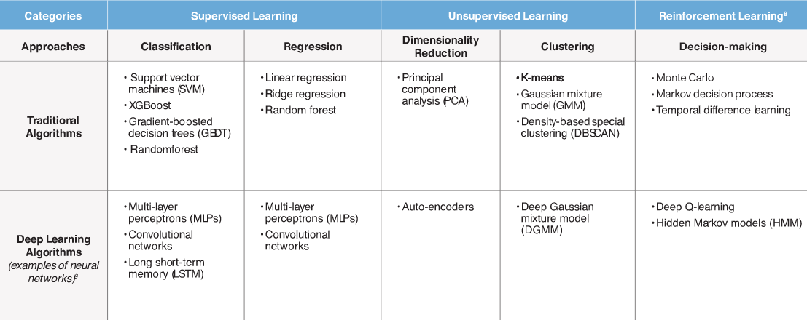
ML Algorithms and Tasks they solve

Slide 70
Linear Regression
What is Linear Regression ?
Assumptions
Coefficients are linear –
y= b0+ b1x
b0 , b1 must be strictly linear
We must be able to express target as a linear function of coeff * predictors ( even if predictors are polynomial)
Homoscedasticity –
constant variance – residual/error must have constant variance and should not have a pattern
Mean of errors is zero
Errors are normally distributed
No Autocorrelation
No Multicollinearity

Slide 71
Linear Regression
Now why do we have these assumptions ?
Our goal is to draw a random sample from a population and use it to estimate the properties of that population
In regression analysis, the coefficients in the regression equation are estimates of the actual population parameters. We want these coefficient estimates to be the best possible estimates!
Because we want the model to be such that –
It ensure –
Less Bias -
Less Variance -
As the sample size increases to infinity, the coefficient estimates converge on the actual population parameters.

Slide 72
Linear Regression
Suppose you request an estimate—say for the cost of a service that you are considering. How would you define a reasonable estimate?
The estimates should tend to be right on target. They should not be systematically too high or too low. That is - they should be unbiased or correct on average.
Recognizing that estimates are almost never exactly correct, you want to minimize the discrepancy between the estimated value and actual value. Large differences are bad!
That is – they should have low variance.
These two properties are exactly what we need for our coefficient estimates!
Less Bias
Less Variance
As the sample size increases to infinity, the coefficient estimates converge on the actual population parameters.

Slide 73
Linear Regression
What happens behind the scenes when the coefficients are computed by Linear Regression
Model
What is the Null Hypothesis ?
How to determine whether the predictor is significant or not ?

Slide 74
Linear Regression
Let’s take the example of auto insurance provider
Open up the file called insurance_losses.csv and start exploring it
The approach will be –
First we will do everything in excel and then in Python

Slide 75
Motivation for Logistic Regression
What if we want to make predictions for Classes ?
We want to predict categories/classes of a target variable
Like 0/1, Default/Non-Default, Subscribed/Non-Subscribed , Malign/Non-Malign
These are special class of problems that fall under Classification
Primarily we make predictions about the target class based on probabilities

Slide 76
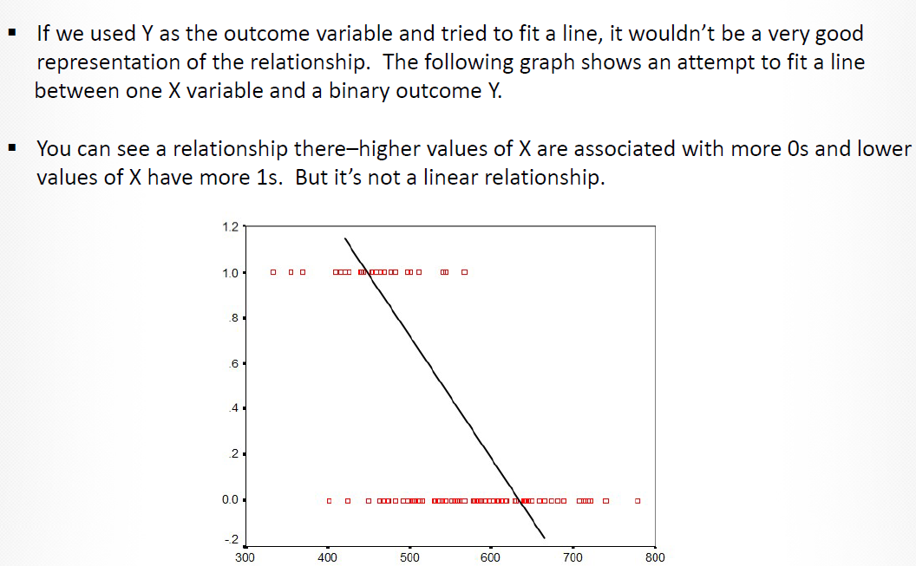
What will happen if we fit Linear Model to such scenarios?
Suppose we are trying to predict whether an employee is going to return back to work or not after being injured in the execution of his official responsibilities.
So basically we are trying to predict
RTW = 0 (will not return)
RTW =1 (will return)

Slide 77
How is it done ? What are Odds ?
Predicting Probabilities or odds
Doing mathematical re-arrangement to predict log(odds)
And then converting it back to a class

Slide 78
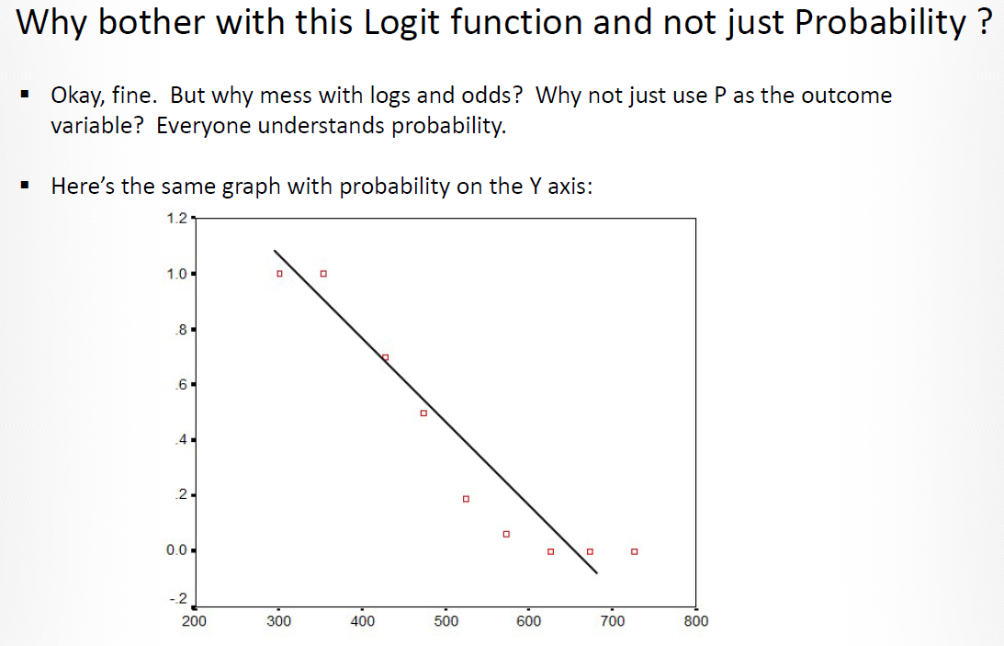
How is it done ? What are Odds ?
Predicting Probabilities or odds
Doing mathematical re-arrangement to
predict log(odds)
And then converting it back to a
class/category

Slide 79
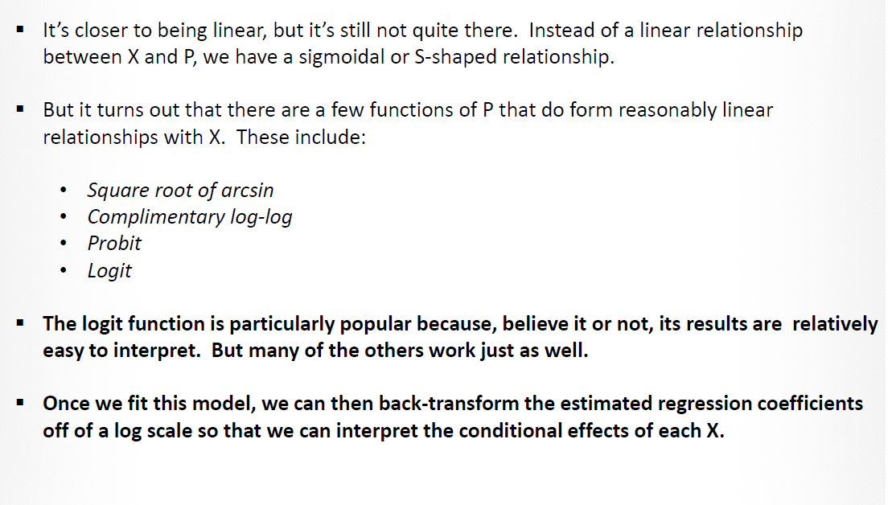
Link Functions – Logit is one of them
Linking Probabilities to the class
The generalized linear model (GLM) is a flexible generalization of ordinary linear
regression that allows for response variables that have other than a normal distribution.
The GLM generalizes linear regression by allowing the linear model to be related to the
response variable via a link function and by allowing the magnitude of the variance of
each measurement to be a function of its predicted value.
It uses an iteratively reweighted least squares method for maximum
Likelihood estimation of the model parameters.
The GLM consists of three elements:
1. A probability distribution from the exponential family.
2. A linear predictor η = Xβ
3. A link function g such that E(Y) = μ = g-1(η).

Slide 80
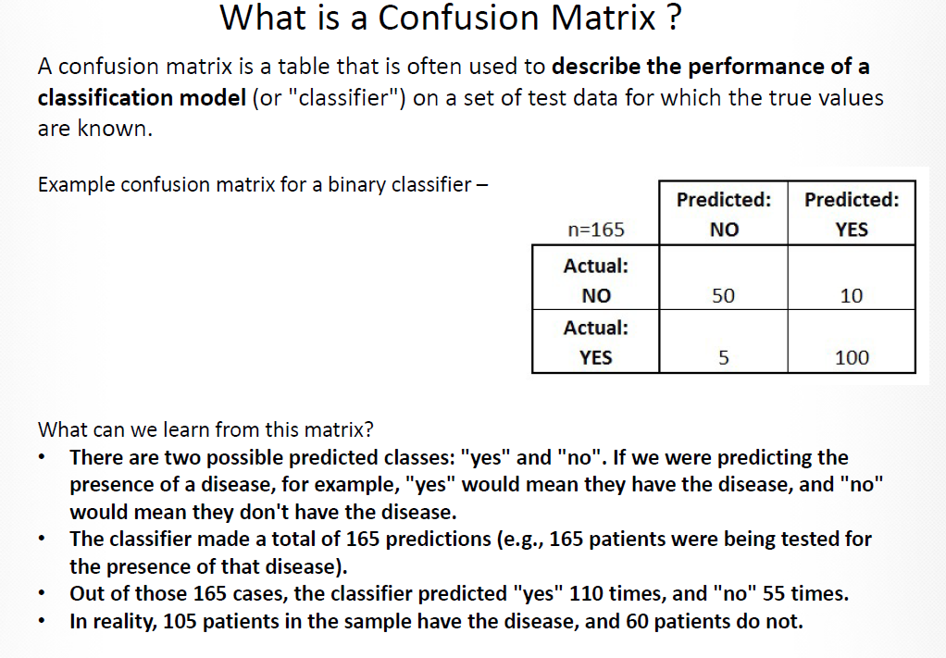
What is a Confusion Matrix ?

Slide 81
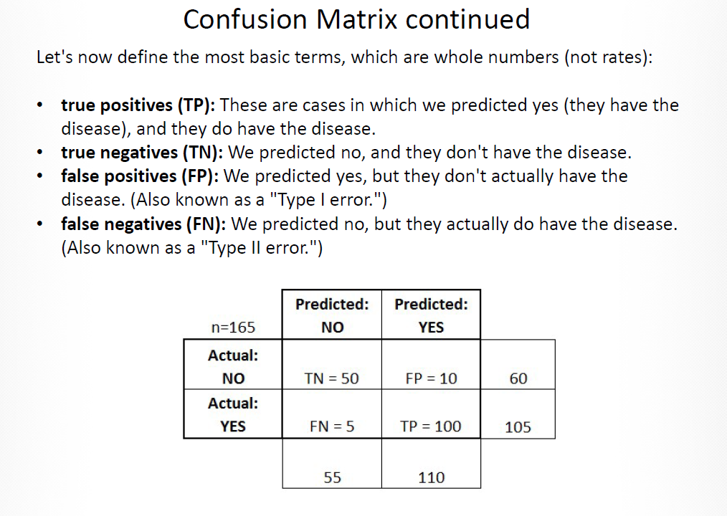
What is a Confusion Matrix ?

Slide 82
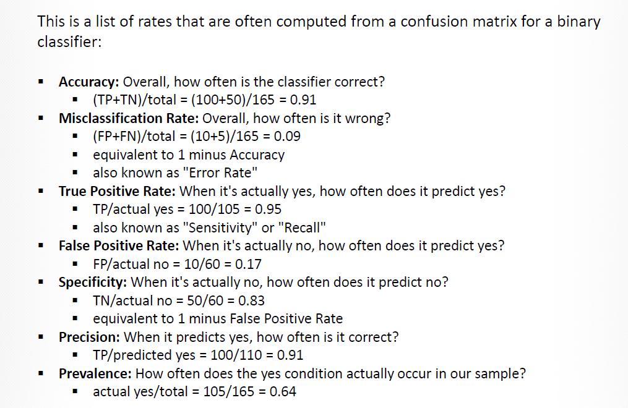
What is a Confusion Matrix ?

Slide 83
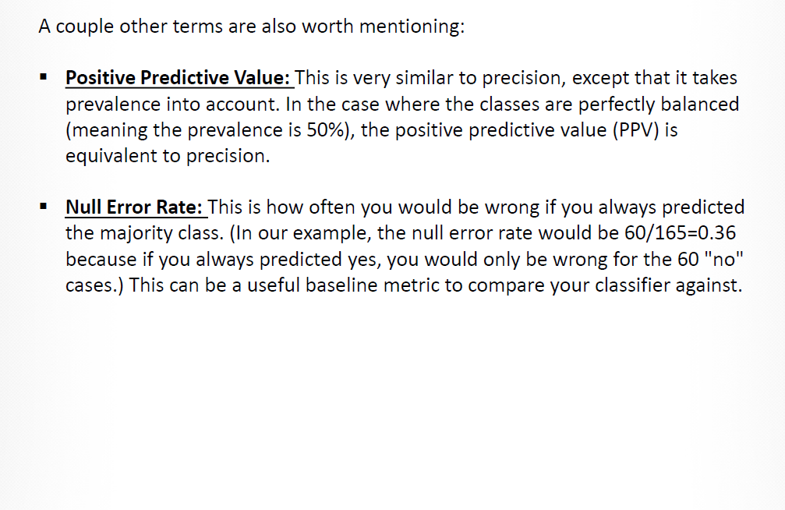
What is a Confusion Matrix ?

Slide 84
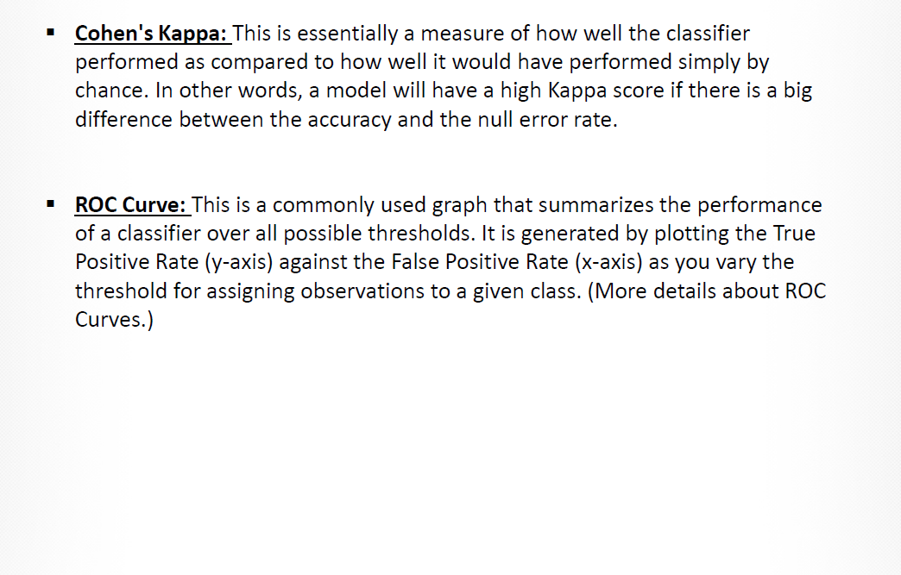
What is a Confusion Matrix ?

Slide 85
What is a Confusion Matrix ?

Slide 86
Significance and Interpretation of AU ROC curve
The area measures discrimination, that is, the ability of the test to correctly classify those with and without the disease.
Consider a situation in which patients are already correctly classified into two groups.
You randomly pick on from the disease group and one from the no-disease group and do the test on both.
The patient with the more abnormal test result should be the one from the disease group.
The area under the curve is the percentage of randomly drawn pairs for which this is true (that is, the test correctly classifies the two patients in the random pair)
A Receiver Operating Characteristic Curve (ROC) is a standard technique for summarizing classifier performance over a range of trade-offs between true positive (TP) and false positive (FP) error rates
A model with high discrimination ability will have high sensitivity and specificity simultaneously,
leading to an ROC curve which goes close to the top left corner of the plot.
A model with no discrimination ability will have an ROC curve which is the 45 degree diagonal line.

Slide 87
Decision Trees
Can perform both Regression and Classification
How do they work ?
http://www.alanfielding.co.uk/multivar/crt/dt_example_03.htm
What is Purity Measure ?
Gini Value
Entropy
Mean Square Error

Slide 88
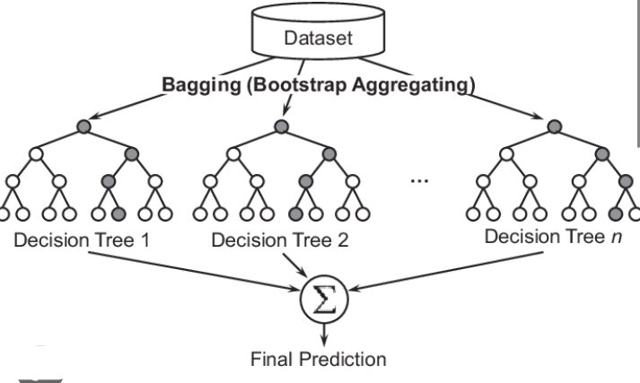
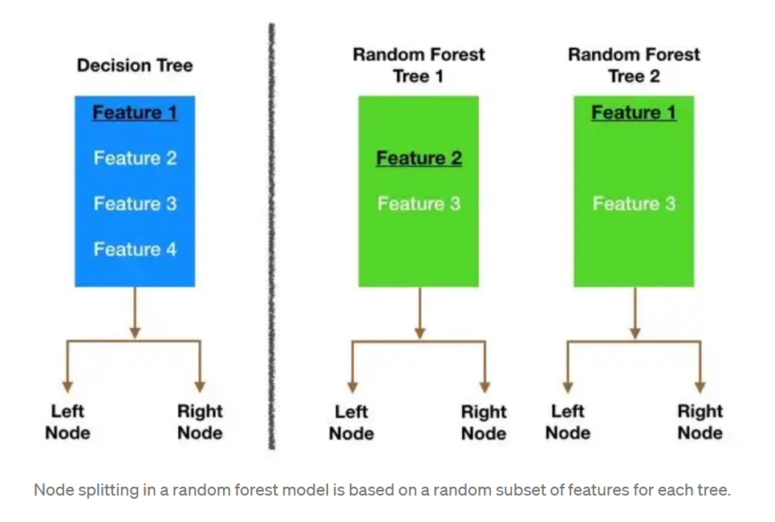
Random Forests
The random forest is a classification algorithm consisting of many decisions trees. It uses bagging and feature randomness when building each individual tree to try to create an uncorrelated forest of trees whose prediction by committee is more accurate than that of any individual tree.
How does it work ?

Slide 89
Clustering
Clustering is an Unsupervised Learning Technique that helps in grouping data points based on some similarity measure (like distance between two points in the data)
This can be used as a starting point to understand the groupings that exist in data

Slide 90
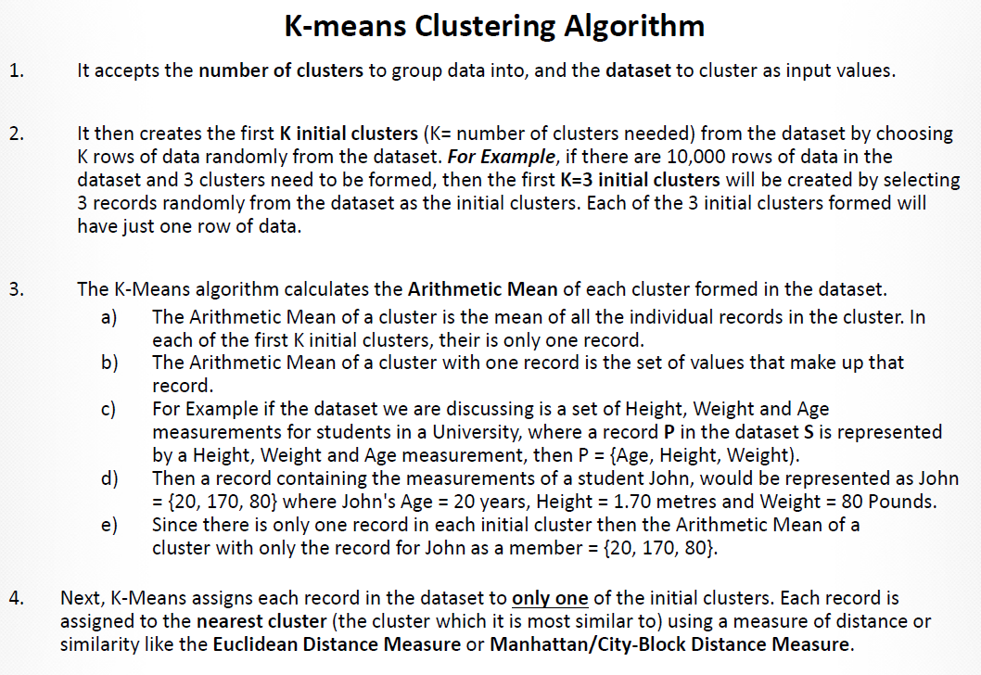

Slide 91
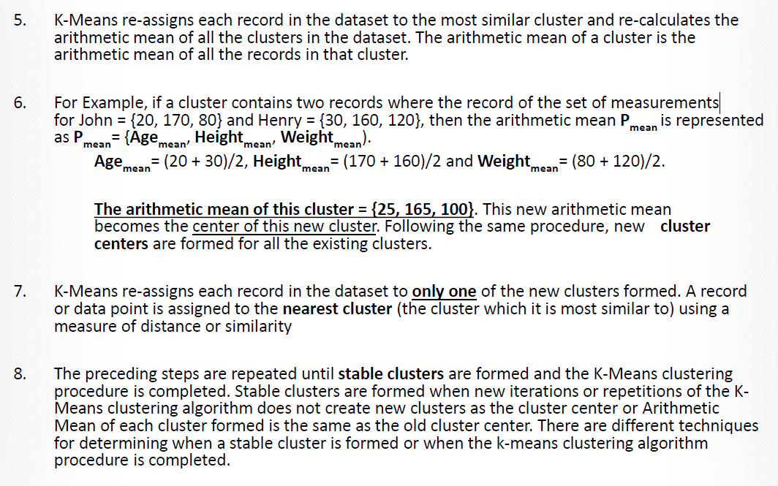

Slide 92
Lets see an example
There are three widely used techniques for how to form clusters in Python: K-means clustering, Gaussian mixture models and spectral clustering.
For relatively low-dimensional tasks (several dozen inputs at most) such as identifying distinct consumer populations, K-means clustering is a great choice.
For more complicated tasks such as illegal market activity detection, a more robust and flexible model such as a Guassian mixture model will be better suited. Finally, for high-dimensional problems with potentially thousands of inputs, spectral clustering is the best option.
Open notebook clustering.ipynb

Slide 93
Lets see an example
There are three widely used techniques for how to form clusters in Python: K-means clustering, Gaussian mixture models and spectral clustering.
For relatively low-dimensional tasks (several dozen inputs at most) such as identifying distinct consumer populations, K-means clustering is a great choice.
For more complicated tasks such as illegal market activity detection, a more robust and flexible model such as a Guassian mixture model will be better suited. Finally, for high-dimensional problems with potentially thousands of inputs, spectral clustering is the best option.
Open notebook clustering.ipynb

Slide 94
Thank You

